Slide 1
Unit 3: Waves Light Waves
Mr. Le
Fall 2017

Slide 2
What you should know about Light waves
Light waves are electromagnetic waves,
so they DO NOT need a medium to travel
They are transverse waves.
They travel in a straight line.

Slide 3
Behaviors of Wave
Don’t have to copy this slide.
When a wave comes into contact with different matter, it does not just change its speed, but something else could happen as well.
We call these the behaviors of a wave.
You will be introduced to 6 of them, but we will mainly focus on 4.

Slide 4
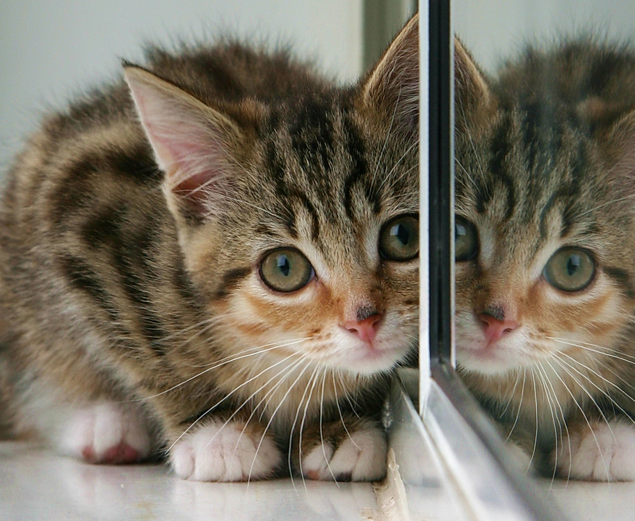
Behavior of Waves
Reflection: when a wave hits an object or surface and bounces off.
Reflection allows humans to see things.

Slide 5
Behavior of Waves

Slide 6
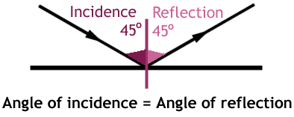
Law of Reflection
Angle of Incidence: the angle in which the wave comes in.
Angle of Reflection: the angle in which the wave bounces off
The Law of Reflections states that these two angles will be equal to each other.

Slide 7
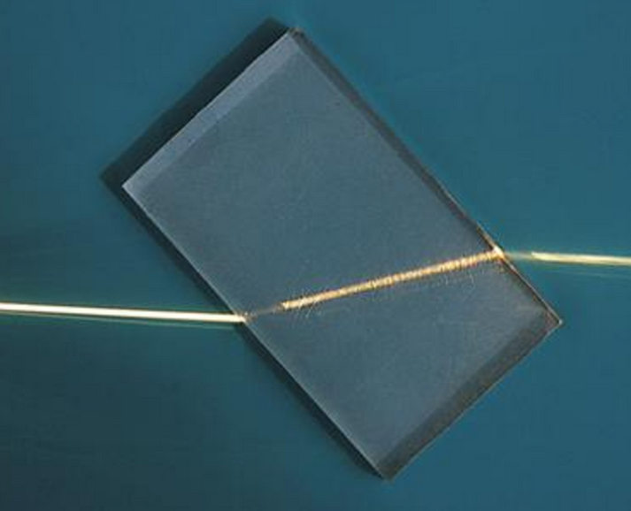
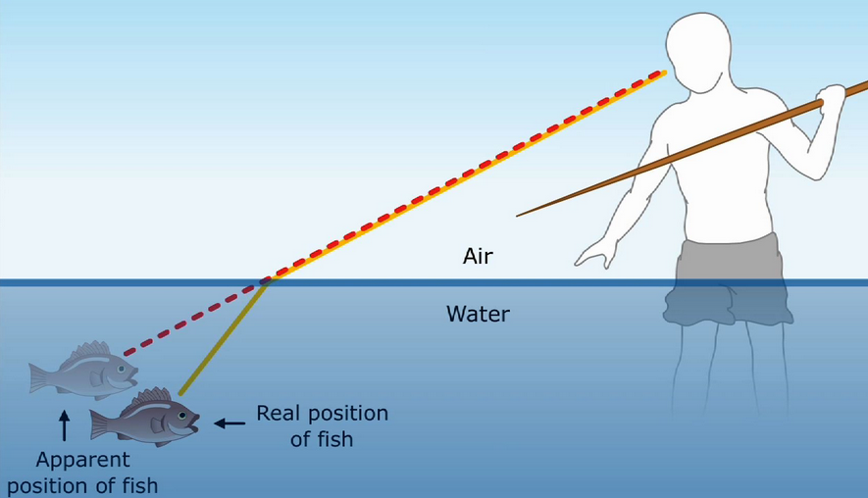
Behavior of Waves
Refraction: when a wave bends as it changes medium (move from one medium to another)
When things look differently than it should, it is most likely due to refraction.

Slide 8
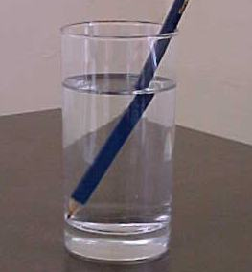
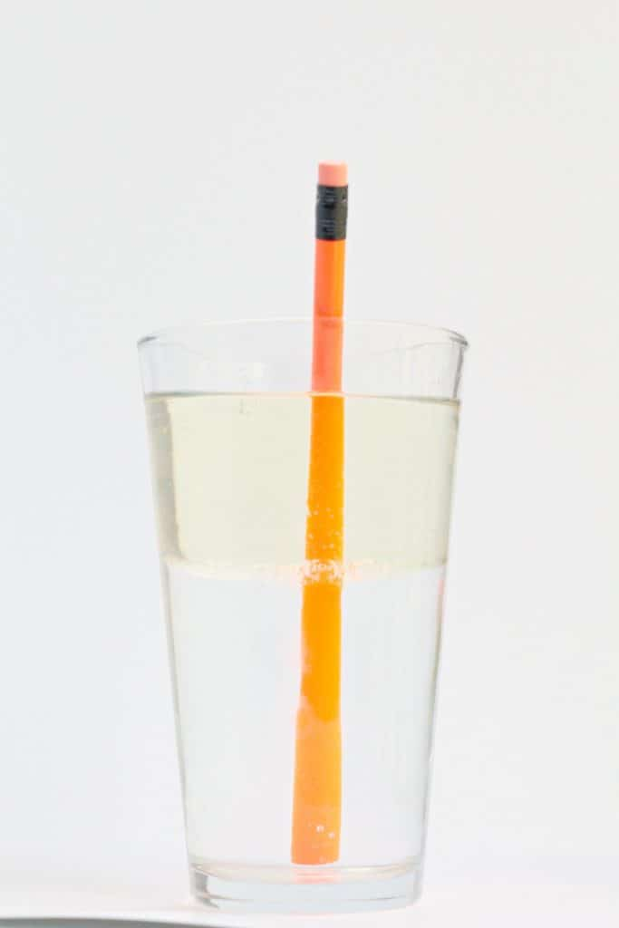
Behavior of Waves

Slide 9
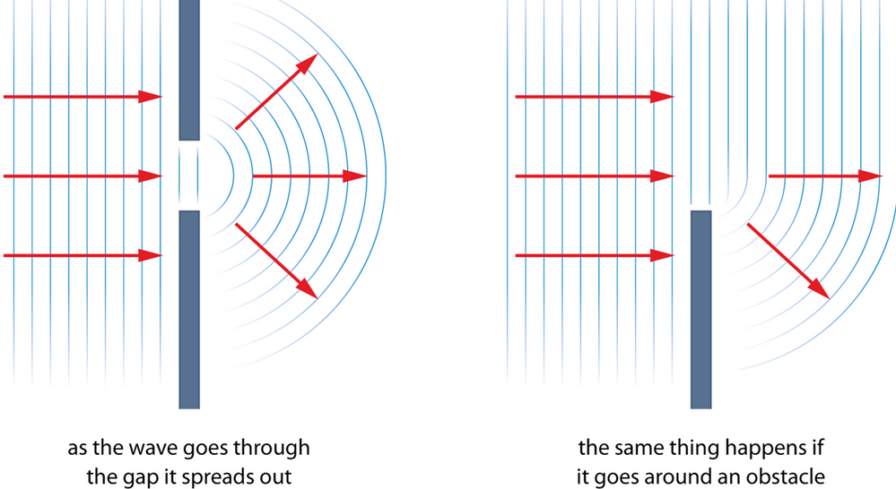
Behavior of Waves
Diffraction: when a wave bends around a barrier or spreads out after passing through an opening.

Slide 10
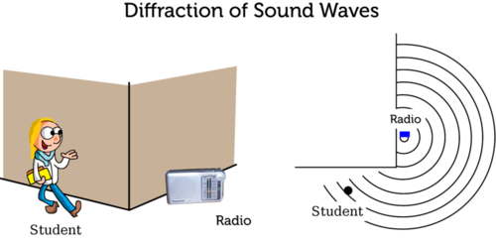
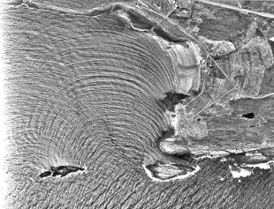
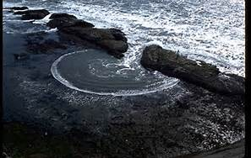
More Examples of Diffraction

Slide 11
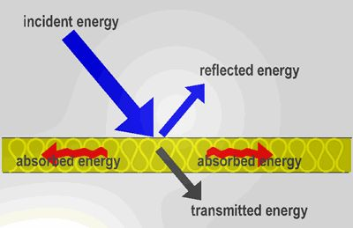
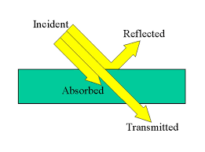
Behavior of Waves
Absorption: when a wave is taken in by the matter.
One of the reasons why we are able to see different colors.

Slide 12
Behavior of Waves
Transmission: when a wave passes through the medium.
Transmission depends on the type of material the wave encounters.

Slide 13
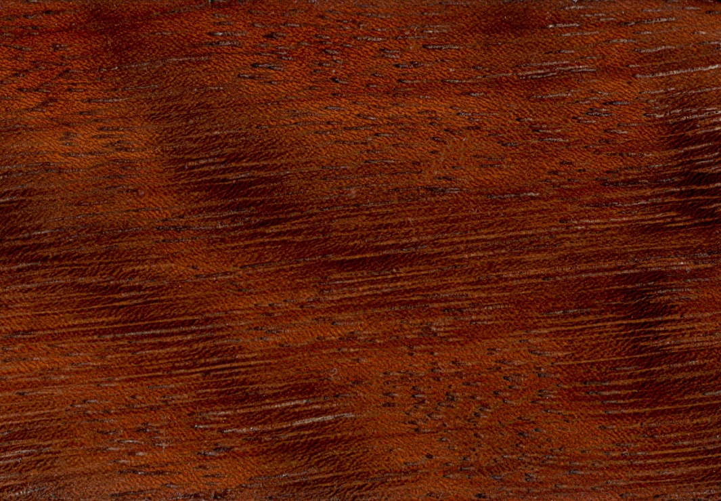
Opaque
Opaque: materials that let no light pass through them.
You can not see through opaque materials
Transmission can not occur.

Slide 14
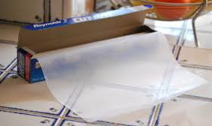
Translucent
Translucent: materials that lets some light to pass through.
You can see through translucent material, but the image is not clear.

Slide 15
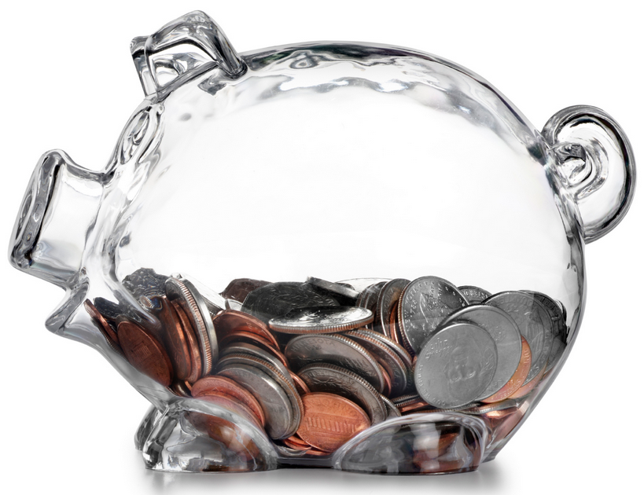
Transparent
Transparent: materials that lets light easily pass through.
You can see through transparent materials and the images are clear.

Slide 16
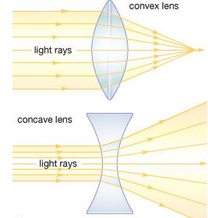
Concave and Convex Lens
Convex lens bend light inward (converge), causing images to look larger.
Concave lens bend light outward (diverge), causing images to look smaller

Slide 17
Behavior of Waves
Interference: when two or more waves meet while traveling through the same medium
After meeting, the two waves will either produce a destructive interference or constructive interference.

Slide 18
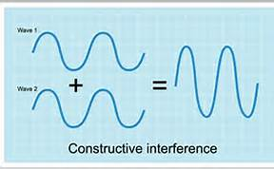
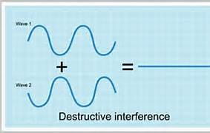
Constructive vs Destructive Interference
Constructive Interference: when two waves meet and create a wave with higher amplitude.
Destructive Interference: when two waves meet and cancel each other out, leaving no wave.

Slide 19
Unit 3: Waves Color
Mr. Le
Fall 2017

Slide 20
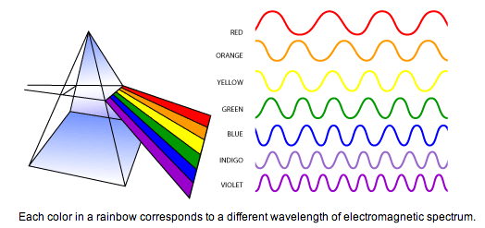
Recall!
There are different colors because each color has their own different wavelengths.

Slide 21
Remember!!
We can see different color objects because of reflection and absorption.
The color you see is the color that is mostly reflected.
The colors you don’t see are absorbed.

Slide 22
Black and White
An object that ABSORBS all colors of visible light will appear black.
Absorb all= black
An object that REFLECTS all colors of visible light will appear white
Reflect all= white

Slide 23
Special colors like pink and brown are NOT reflected.
If you see pink, it does not mean pink is reflected because it is not a color of visible light.
Remember it is not just 1 color that is reflected. It can be a combination and intensity of the colors of visible light that are reflected and absorbed to give you the variety of colors.

Slide 24
Unit 3: Waves Eyes
Mr. Le
Fall 2017

Slide 25
How do we see?
1. Light is reflected off an object or surface and travels to our eyes.
2. Nerves change the light into electro-chemical signals, then these signals are carried to the brain.
3. Once the brain receive the information it must interpret (figure out) the information. Once this is done, vision occurs.

Slide 26
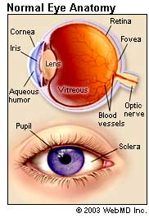
Parts of your Eyes
Cornea- outermost layer of the eye, acts as a shield and focuses the light that enters the pupil.
Pupil- dark spot in
the middle, allows light to enter
Iris- colored part of the eye, controls how much light enters
Sclera- white part of the eyes, provides strength and protection

Slide 27
Parts of your Eyes
Lens- located behind the pupil, allows the eyes to focus on small details
Vitreous Humour- gel that surrounds the eyes, helps keep the circular shape
Retina- located at the back of the eyes, receives information and transfers it to the brain

Slide 28
Photoreceptors
Rods
Cones
Use when there is little light
Lets you see black and white
Mostly found at the edges of the retina
Use when there is a lot of light
Lets you see color
Mostly found at the center of the retina

